Slide 1
UNIT – II-b
Requirement Engineering:
Requirement Engineering tasks,
Initiating the Requirements Engineering Process, Eliciting Requirements

Slide 2
Requirements Engg.
Helps s/w engg’s to better understand the pblm they will work to solve.
Encompasses the set of tasks that lead to an understanding of
-what the buss. impact of the s/w will be,
-what the customer wants, and
-how end-users will interact with the s/w.
S/w engg’s (sometimes referred to as sys. engg’s or analysts in the IT world) and
other prjt stakeholders (managers, customers, end- users) all participate in requirements engg.

Slide 3
A Bridge to Design and Construction
Designing and building comp. s/w is challenging, creative, and just plain fun.
RE, like all other s/w engg. activities, must be adapted to the needs of
the process,
the project,
the product, and
the people doing the work.

Slide 4
In perspective process models, RE is a s/w engg. action that begins during the communication activity and continues into the modeling activity.
It is essential that the s/w team make a real effort to understand the requirements of a pblm before the team attempts to solve the pblm.
RE builds a bridge to design and construction.

Slide 5
The journey across the bridge takes us high above the prjt, allowing
s/w team to examine the context of the s/w work to be performed;
the specific needs that design and construction must address;
the priorities that guide the order in which work is to be completed; and
the info., functions, and behaviors that will have a profound impact on the resultant design.

Slide 6
Requirements Engineering Tasks
The RE process is accomplished through the execution of 7 distinct functions:
1)inception, 2)elicitation, 3)elaboration, 4)negotiation, 5)specification, 6)validation, and 7)management.

Slide 7
Inception
s/w engg’s ask a set of context-free questions.
I.First set(focuses on cust. & other stakeholders) of context-free questions:
Who is behind the request for this work?
Who will use the solution?
What will be the economic benefit of a successful solution?
Is there another source for the solution that you need?

Slide 8
II.Next set of questions (enables the s/w team to gain a better understanding of the pblm ):
How would you characterize "good" output that would be generated by a successful solution?
What pblm (s) will this solution address?
Can you show me (or describe) the buss environment in which the solution will be used?
Will special performance issues or constraints affect the way the solution is approached?

Slide 9
III.Final set of questions( focuses on the effectiveness of the communication activity itself):
Are you the right person to answer these questions? Are your answers "official"?
Are my questions relevant to the problem that you have?
Am I asking too many questions?
Can anyone else provide additional information?
Should I be asking you anything else?

Slide 10
Intent:
-To establish a basic understanding of the pblm,
-The people who want a solution,
-The nature of the solution that is desired, and
-The effectiveness of preliminary communication and collaboration b/n the
customer and the developer.

Slide 11
2.Elicitation
It certainly seems simple enough
—ask the customer, the users, and others what the objectives for the system or product are,
-what is to be accomplished,
-how the system or product is to be used on a day-to- day basis.
- But it isn't simple—it's very hard.

Slide 12
-Christel and Kang identified a no. of pblms that help us understand why requirements elicitation is difficult:
Problems of scope:
The boundary of the system is ill-defined or the customers/users specify unnecessary technical detail that may confuse.
Problems of understanding:
The customers/users are not completely sure
of what is needed, have a poor understanding of the capabilities.
don't have a full understanding of the pblm domain,

Slide 13
Problems of volatility:
The requirements change over time.
To overcome these pblms, REs must approach the requirements gathering activity in an organized manner.

Slide 14
3.Elaboration
The info. obtained from the customer during inception and elicitation is expanded and refined during “elaboration”.
This requirements engg. activity focuses on developing a refined technical model of s/w functions, features and constraints.

Slide 15
Negotiation
It is unusual for customers and users to ask for
more than can be achieved, given limited buss resources.
It is also relatively common for diff. customers or users to propose conflicting requirements, arguing that their version is "essential for our special needs."
The requirements engg. must reconcile these conflicts through a process of negotiation.

Slide 16
Rough "guestimates” of development effort are made and used to assess the impact of each requirement on project cost and delivery time.
Using an iterative approach, requirements are eliminated, combined, and/or modified so that each party achieves some measure of satisfaction.

Slide 17
Specification: In the context of s/w, the term specification means diff. things to diff. people.
It can be
a written doc.,
a set of graphical models,
a formal mathematical model,
a collection of usage scenarios,
a prototype, or any combination of these.
"standard template" should be developed and used for a specification.
It describes the function and performance of a comp.-based sys. and the constraints that will
govern its development.

Slide 18
6.Validation
The work products produced as a consequence of RE are assessed for quality during a validation step.
It examines the specification to ensure that all s/w requirements have been stated unambiguously, that inconsistencies, omissions, and errors have been detected and corrected

Slide 19
7.Requirements management
It is a set of activities that help the prjt team identify, control, and track requirements & changes to requirements at any time as the project proceeds.
It is similar to SCM.
RM begins with identification.
Each requirement is assigned a unique identifier.
Once requirements are identified, traceability table(TT) are developed, each TT relates requirements to one or more aspects of the sys. or its environment.

Slide 20
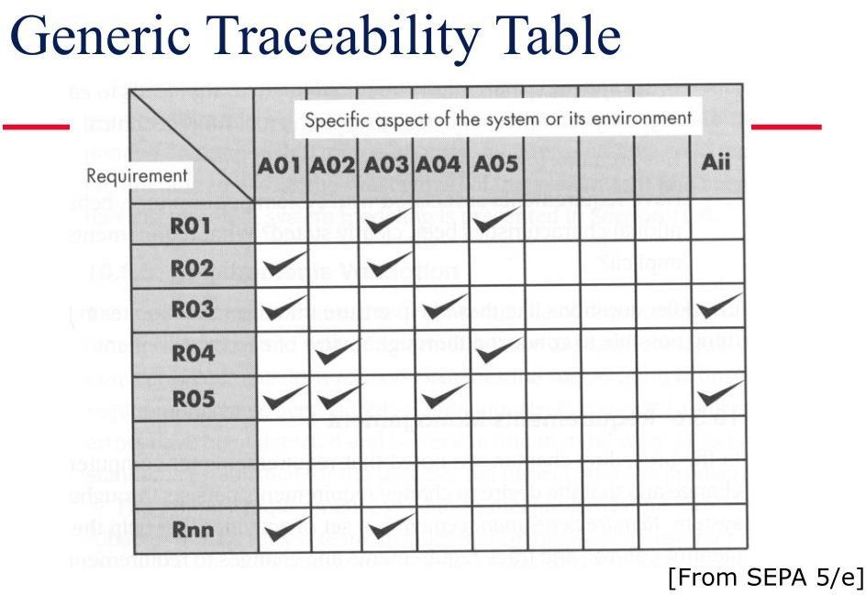
The following are the diff. possible TTs:
Fig 7.1 generic traceability table(from TB)

Slide 21
Software Requirements Specification Document (SRS)

Slide 22
Systems Requirements Specification
SRS is the official statement of what the system developers should implement.
SRS is a complete description of the behavior of the system to be developed.
SRS should include both a definition of user
requirements and a specification of the system requirements.
The SRS fully describes what the software will do and how it will be expected to perform.

Slide 23
Systems Requirements Specification
Table of Contents:
Introduction
General Description
Functional Requirements
Non Functional Requirements

Slide 24
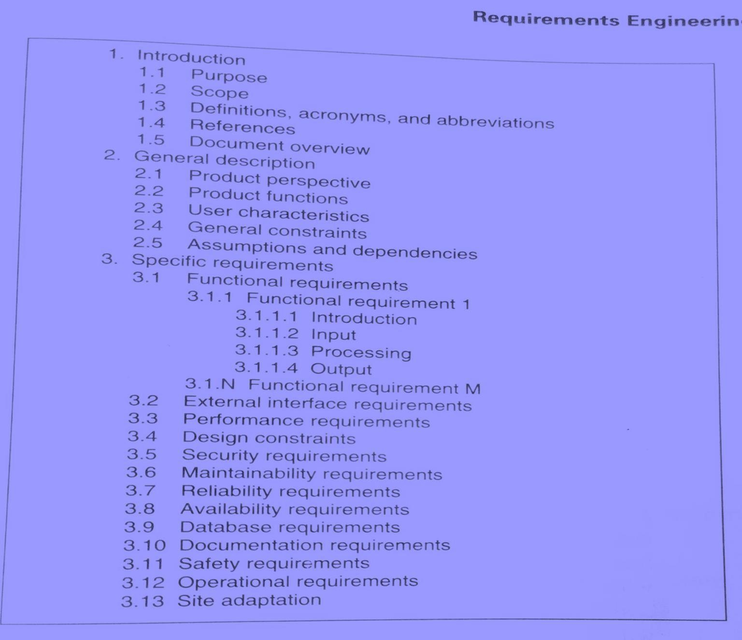

Slide 25
Systems Requirements Specification
INTRODUCTION
Purpose
Describe the purpose of the SRS, not the purpose of the software being developed.
Intended audience for SRS.
Scope
Describe application of software (benefits, objectives).
Explain what software will (not) do.

Slide 26
Example (video Rental System)
Purpose
The purpose of the Software Requirements Specification document is to clearly define the system under development, namely the Video Rental System (VRS). The intended audience of this document includes the owner of the video store, the clerks of the video store, and the end users of the VRS.
*Other intended audience includes the development team such as the requirements team, requirements analyst, design team, and other members of the developing organization.

Slide 27
Scope
The owner of a local video store wanted to create a new business plan where everything about renting a video (except the picking up and returning of videos) was done online.
Therefore, the new VRS will allow the following functionality online:
to search for videos,
to become members,
to rent videos,
to modify membership information,
and to pay overdue fees.
-The store personnel may use the VRS to process the rented or returned videos, to add or remove videos to/from his store’s video inventory and to update video information.
-The VRS is intended to increase the owner’s profit margin by increasing video sales with this unique business approach and by allowing him to reduce the staffing needed in his stores.

Slide 28
Definitions/acronyms/abbreviations
Definitions of terms and abbreviations that are used in the SRS.
E.g.
User: The person operating and/or using the software system.
References
A complete list of all documents referenced elsewhere in the SRS.
Specify the sources from which the references can be obtained.
Overview
Brief description of rest of SRS.
How the SRS is organized

Slide 29
2.OVERALL DESCRIPTION
Product Perspective
If the product is independent and totally self-contained, it should be stated here.
Describe the functions of each component of the larger system or project, and identify interfaces.
Product Functions
Provide a summary of the functions that the software will perform.
User Characteristics
Describe those general characteristics of the eventual users of the product that will affect the specific requirements.

Slide 30
General Constraints
Provide a general description of any other items that will limit the developer's options for designing the system.
In this section, the constraints of the system are listed. They include hardware, network, system software, and
software constraints. It also includes user constraints, processing constraints, timing constraints, and control
limits.
E.g.
The software system will run under Windows.
All code shall be written in Java.

Slide 31
Assumptions and Dependencies
List and description of each of the factors that affect the requirements stated in the SRS.

Slide 32
Example
A Product Perspective
The VRS is a web-based system.
The system interfaces with two other systems, the owner’s email system,
the video distributor’s video system, and the browsers used by VRS customers.
The system provides a secure environment for all financial transactions and for the storing and retrieving of confidential member information.

Slide 33
Example
Product Functions
The VRS allows customers to search the video inventory provided by this video store. To rent videos through the VRS, one must register as a member using the VRS. Upon becoming a member and logging into the VRS, the VRS provides the functionality for renting videos, modifying membership information, and paying overdue fines.

Slide 34
The clerks of the video store use VRS to process the return of rented videos. The owner of the video store uses VRS to add new videos into the system, remove videos from the system, and modify video information.

Slide 35
The VRS sends emails to members concerning video rentals. One day before a rented video is due to be returned, VRS emails the member a reminder of the due date for the video(s). For any overdue videos, VRS emails the member every 3rd day with overdue notices. At the 60-day limit for outstanding videos, VRS debits the member’s credit card with the appropriate charge and notifies the member of this charge.

Slide 36
Systems Requirements Specification
User Characteristics
The three main groups of VRS users are customers, members, and store personnel. A customer is anyone who is not a member. The customer can only search through the video inventory. The amount of product training needed for a customer is none since the level of technical expertise and educational background is unknown. The only skill needed by a customer is the ability to browse a website.
Member is someone who has registered with VRS. A member can rent videos and pay fees online. As with a customer, these activities require no product training since the level of technical expertise and educational background of a member is unknown. The only skill needed by a member is the ability to browse a website.
The store personnel are divided into two groups: the clerk-level personnel and owner-level personnel. Their educational level is unknown and both group needs little to no training.

Slide 37
Systems Requirements Specification
General Constraints
This system provides web access for all customer and member functions. The user interface will be intuitive enough so that no training is required by customers, members, or store personnel. All online financial transactions and the storage of confidential member information will be done in a secure environment. Persistent storage for membership, rental, and video inventory information will be maintained.

Slide 38
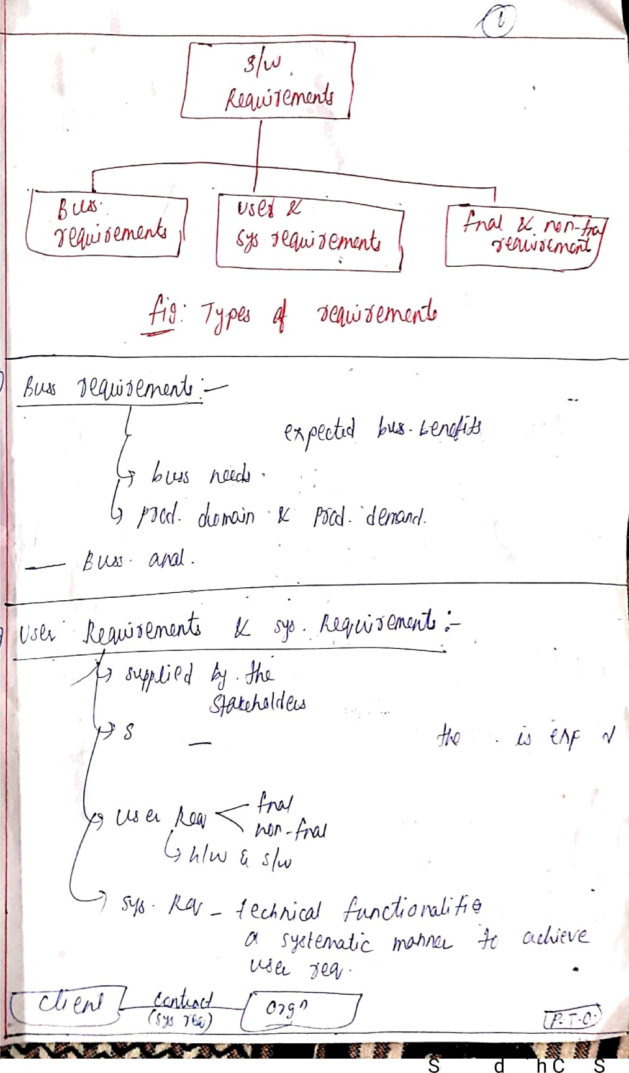
¿zx ^a> , e*y f«a
4p 4
J /y
j-f |so‹i“de
¿/+rz«nz•fia f/d
sn) n Č š*^'”^
‘y ‹*
M))@@ )Čh•lm•¡•d-
//*=.›‹
canne
wit am canner

Slide 39
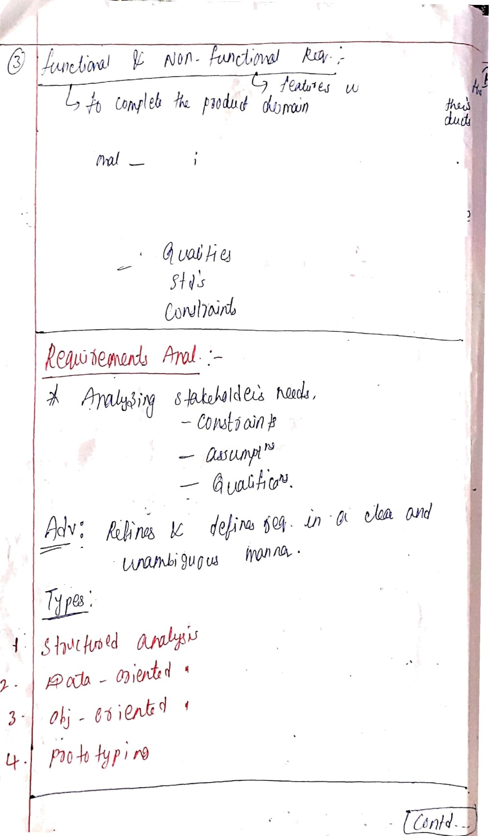

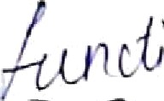
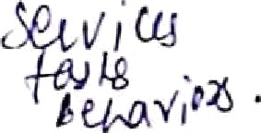
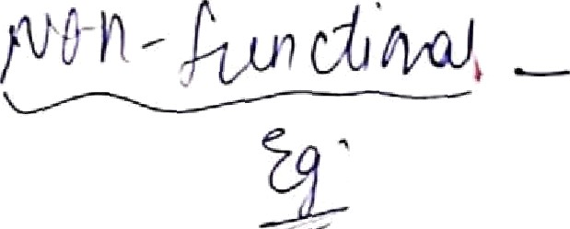
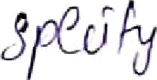
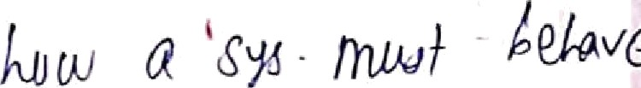
Scanned with CamScanner

Slide 40
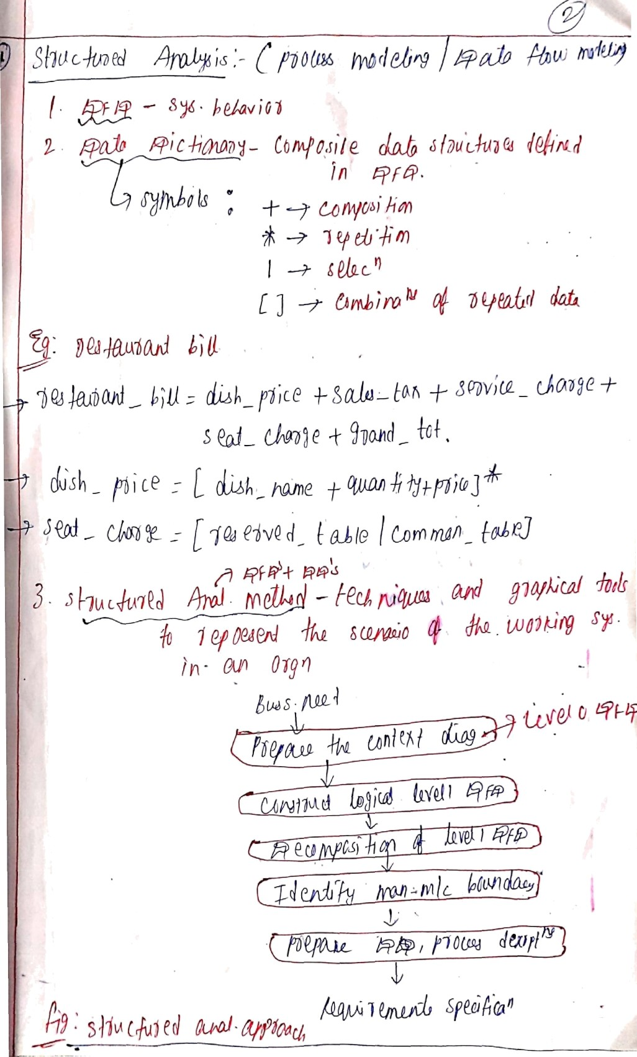
T-¢
Scanned with CamSčanner

Slide 41
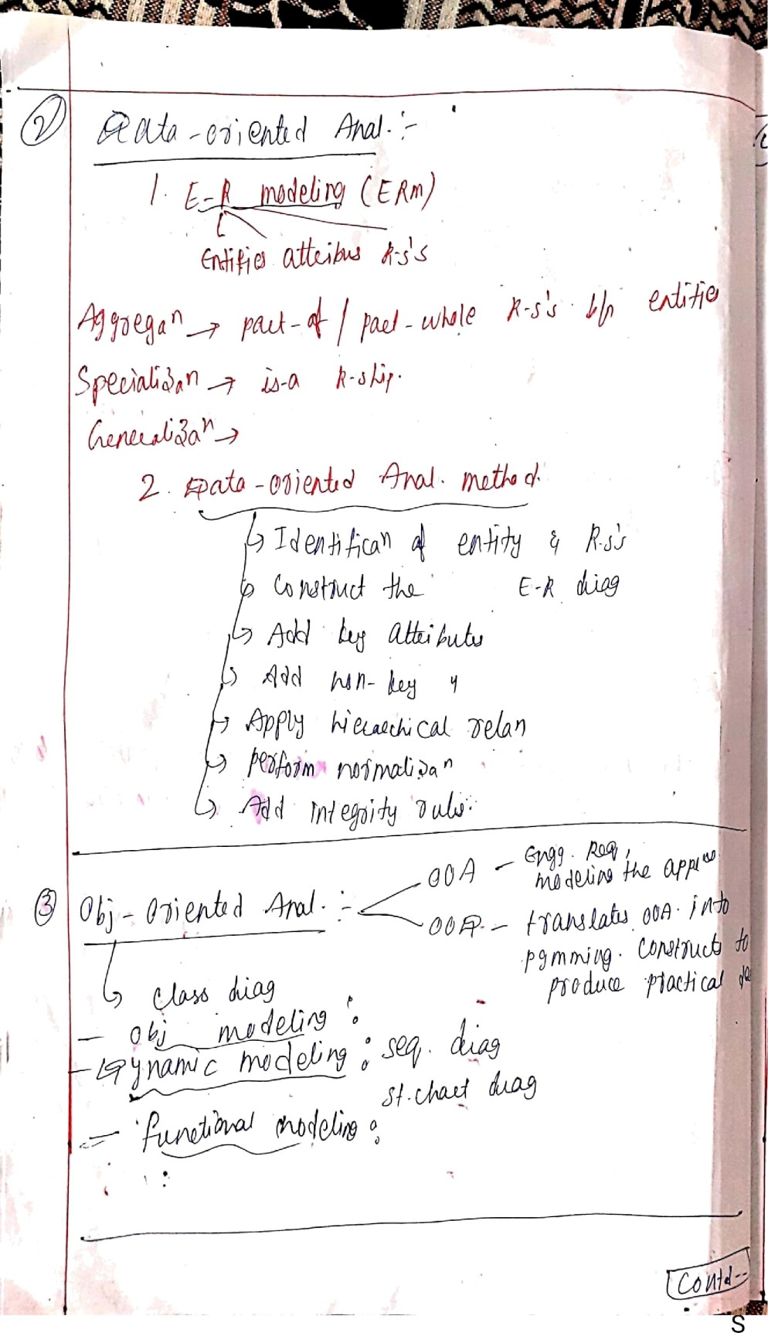
ă&' t
Scanned with Cam canner

Slide 42
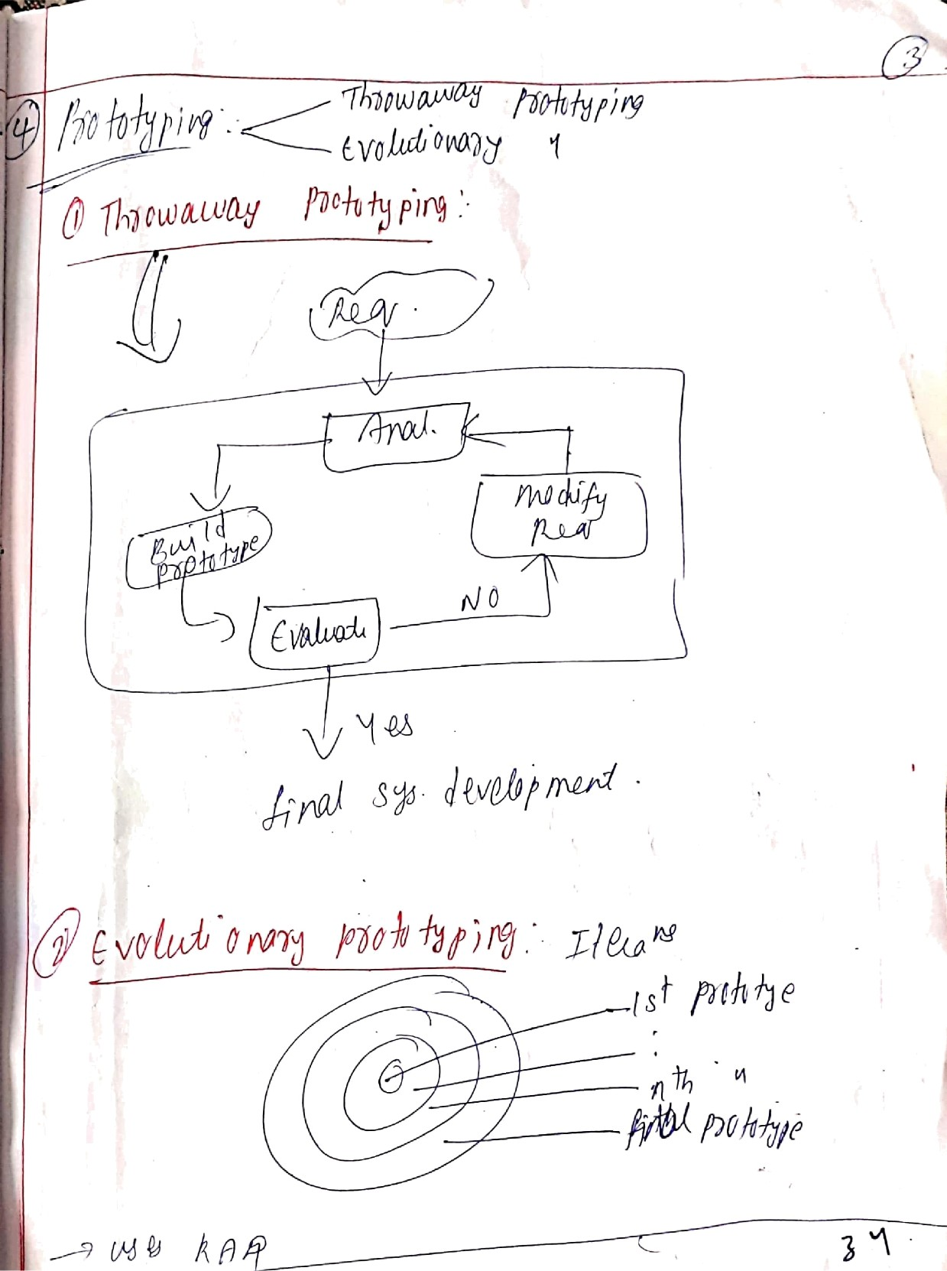
Scanned with CamScanner

Slide 43
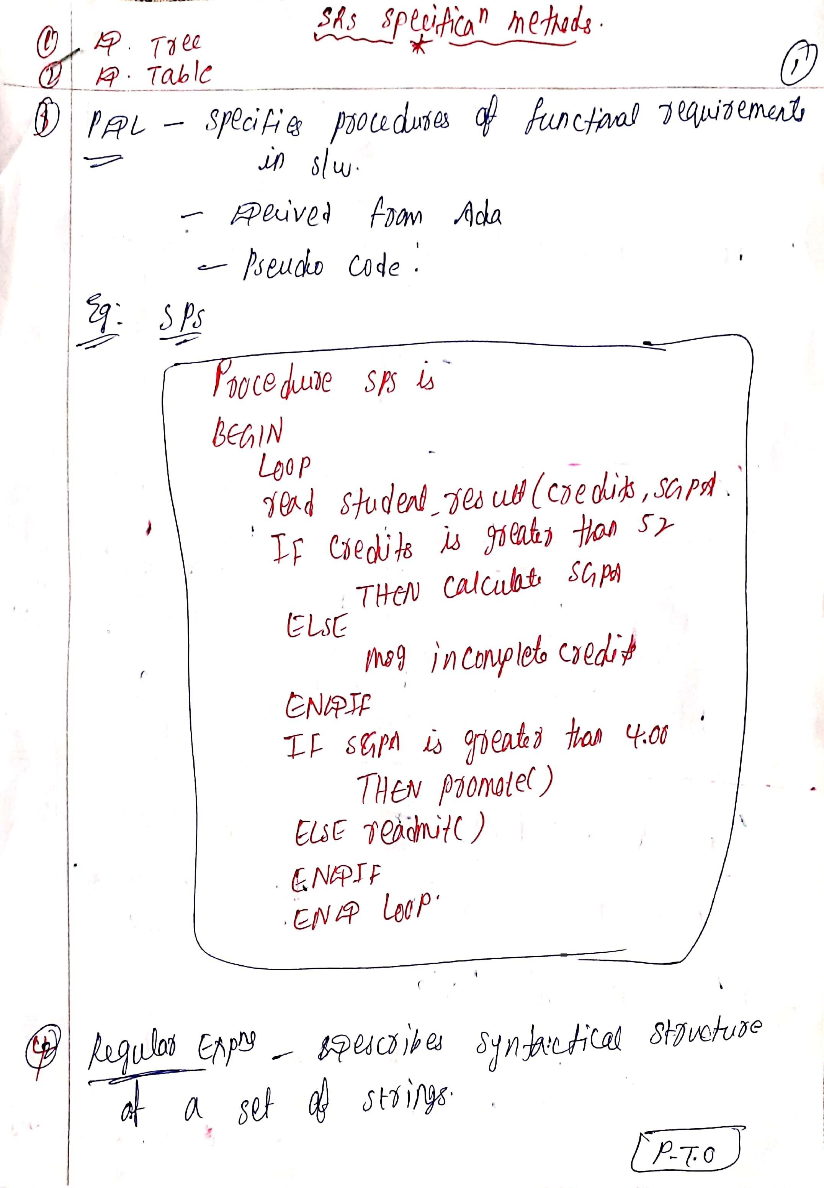

Slide 44
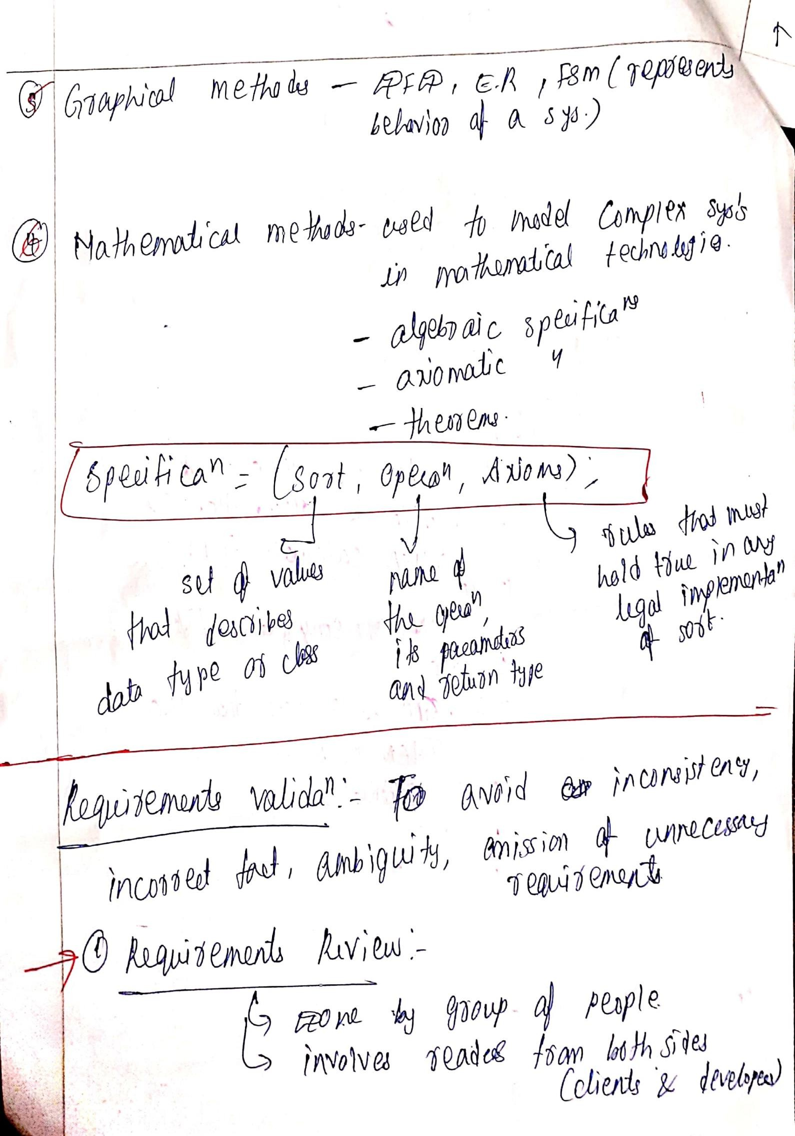

Slide 45
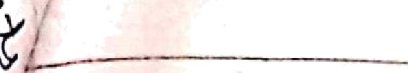
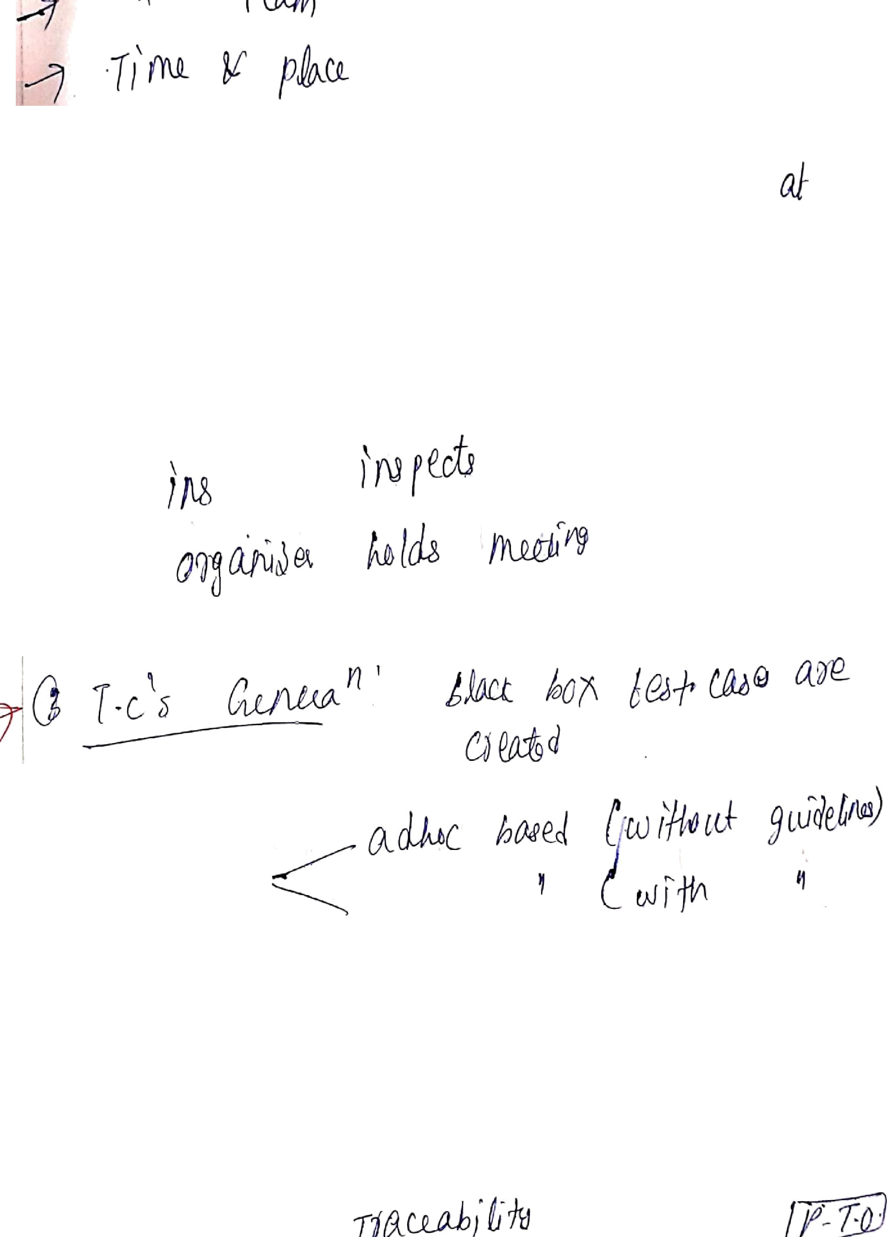
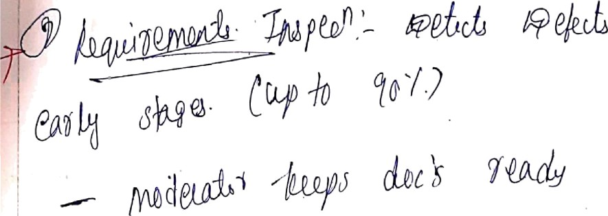
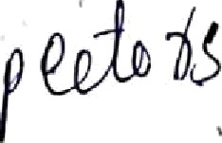


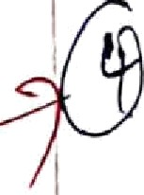
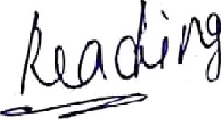

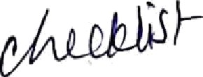
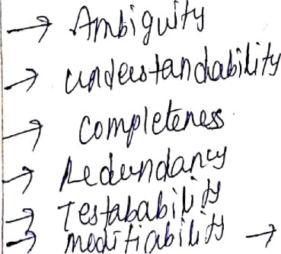

Scanned with
amscanner

Slide 46

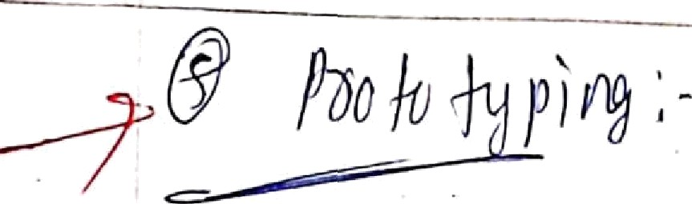
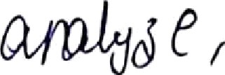
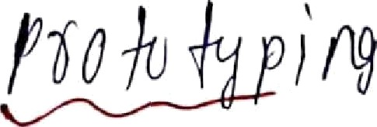
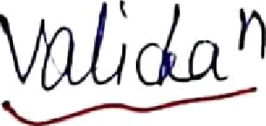
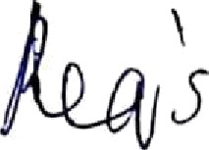
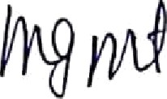



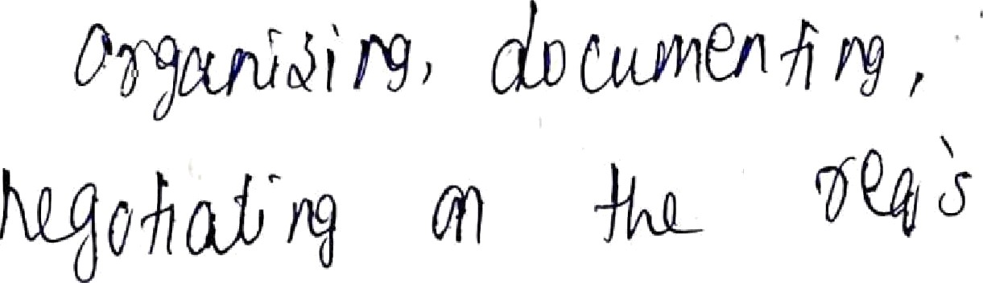

Scanned with CamScanner

